Slide 1
MAXIMA-LAB-1
ENGINEERING MATHEMATICS-II
UE18MA151

Slide 2
Vectors
How to plot a vector using Maxima?

Slide 3
Problem -1
Plot the vector a: [1,2,3];b: [2,-1,4];

Slide 4
Solution
a: [1,2,3];
b: [2,-1,4];
draw3d(proportional_axes = xyz,
xrange = [-3,3],
yrange = [-3,3],
zrange = [-5,5],
xyplane=-3,
enhanced3d=true,
head_angle = 25,
head_length = 0.1,
color=red,
vector([0,0,0],[1,2,3]),
color=blue,
vector([0,0,0],[2,-1,4]))$
Notes:
load("draw"); draw3d(vector([0, 0, 0], [100, 0, 0]), vector([0, 0, 0], [0, 100, 0]), vector([0, 0, 0], [0, 0, 100]));

Slide 5
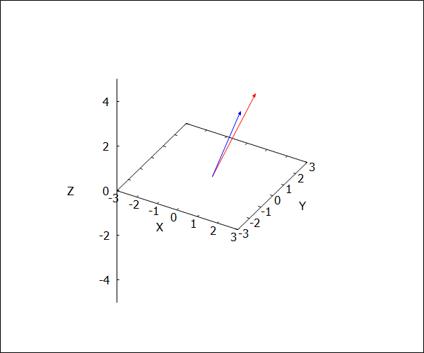
Output

Slide 6
Vector algebra
We can do the standard addition and scalar multiplication of vectors.

Slide 7
Problem-2
If a: [1,2,3] ,b:[2,-1,4] &c:[-5,2,9] are three vectors then find the following.
i) 3*a
ii) a+b
iii) a x b
iv) a.(bxc)
v)|a|
vi) a x (bxc)

Slide 8
i) 3*a
Solution:
a: [1,2,3];
3*a;
Output:
[3,6,9]
Notes:
head_angle indicates the angle, in degrees, between the arrow heads and the segment. Default value: 45

Slide 9
To plot 3*a
draw3d(proportional_axes = xyz,
xrange = [-10,10],
yrange = [-10,10],
zrange = [-10,10],
xyplane = 0,
head_angle = 75,
head_length = 0.2,
color=red,
vector([0,0,0],[1,2,3]),
color=blue,
vector([0,0,0],[3,6,9]))$
Notes:
head_length indicates, in x-axis units, the length of arrow heads. Default value: 2

Slide 10
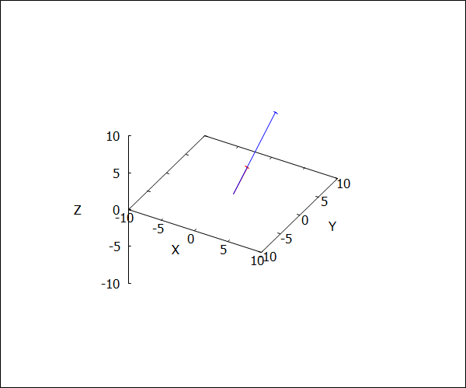
Output

Slide 11
ii) a+b
Solution:
a: [1,2,3];
b: [2,-1,4];
a+b;
Output:
[3,1,7]

Slide 12
To plot a+b
draw3d(proportional_axes = xyz,
xrange = [-10,10],
yrange = [-10,10],
zrange = [-10,10],
xyplane = 0,
head_angle = 25,
head_length = 0.1,
color=red,
vector([0,0,0],[1,2,3]),
color=blue,
vector([0,0,0],[2,-1,4]),
color=yellow,
vector([0,0,0],[3,1,7]))$

Slide 13
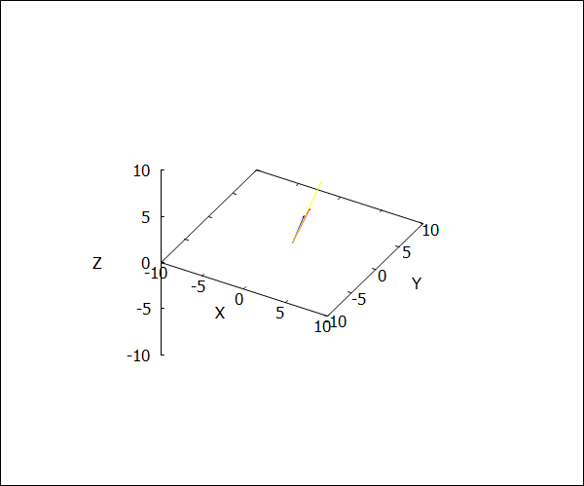
Output

Slide 14
Multiplication of vectors
The dot product operator is a simple period "." between the vectors
To find cross product we must load a special package, the vect package, which is included with Maxima.
The symbol for the cross product is the tilda "~" up on the left corner of the keyboard (you need to do Shift to get it).

Slide 15
iii) a x b
load(vect);
a:[1,2,3];
b:[2,-1,4];
a ~ b;
express(%);
Output:
(a) [1,2,3]
(b)[2,-1,4]
(%o7) [1,2,3]~[2,-1,4]
(%o8) [11,2,-5]
Notes:
Always load vector package for crossproduct

Slide 16
To Plot a x b
load(draw);
draw3d(proportional_axes = xyz,
xrange = [-12,12],
yrange = [-10,10],
zrange = [-12,12],
xyplane = 0,
head_angle = 25,
head_length = 0.1,
color=red,
vector([0,0,0],[1,2,3]),
color=blue,
vector([0,0,0],[2,-1,4]),
color=green,
vector([0,0,0],[11,2,-5]))$

Slide 17
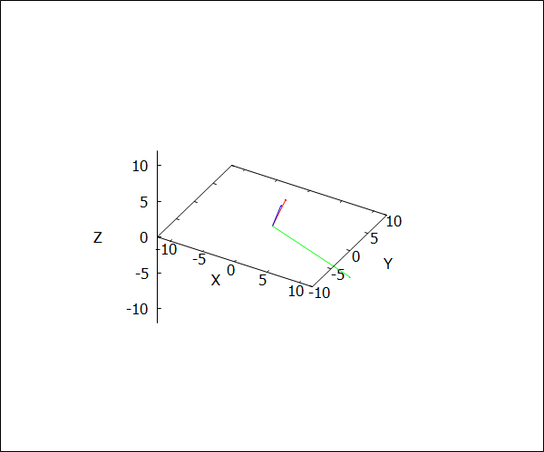
Output

Slide 18
iv) a.(bxc)
load(vect);
a:[1,2,3];
b:[2,-1,4];
c: [-5, 2, 9];
a . (b ~ c);
express(%);
Output:
[1,2,3]
(b)[2,-1,4]
(c)[-5,2,9]
(%o5) -[1,2,3] . [-5,2,9]~[2,-1,4]
(%o6) -96

Slide 19
v)|a|
load(vect);
a:[1,2,3];
sqrt(a . a);
Output:
[1,2,3]
(%o3) sqrt(14)

Slide 20
vi) a x (bxc)
load(vect);
a: [1,2,3];
b:[2,-1,4];
c: [-5, 2, 9];
a~(b~c);
express(%);
express(%);
Output:
[112,-50,-4]

Slide 21
MAXIMA LAB -2

Slide 22
Gradient of a scalar point function

Slide 23

Problem-3
If $φ\left(x,y\right)=e^{x^{2}}sin\left(y\right)$ find gradient of$φ\left(x,y\right)$ .

Slide 24
Solution
load(vect);
%phi(x,y) := exp(x^2) * sin(y);
scalefactors([x,y]);
g: grad(%phi(x,y));
ev(express(g), diff);
define(g(x,y), %);
load(plotdf);
plotdf(g(x,y),[x,y],
[x,-4,4],[y,-4,4],[vectors,"blue"]);
Notes:
Plotdf means plotting directional field

Slide 25

Problem 4
5) Find the directional derivative of the function $φ=x^{2}y^{3}z^{4}$ at the point(1,2,3) in the direction of the vector <3,1,-2>.

Slide 26
load(vect);
%phi(x,y,z):= x^(2).y^(3).z^(4);
a:[3,1,-2];
scalefactors([x,y,z]);
g:grad(%phi(x,y,z));
ev(express(g),diff);
define(g(x,y,z),%);
(g(1,2,3). a) / sqrt(a. a);
Notes:
Output: 3132/sqrt(14)

Slide 27

Problem-5
Find the angle between the surfaces $x^{2}+y^{2}+z^{2}=9,z=x^{2}+y^{2}−3$at the point (2,-1,2).

Slide 28
Solution
load(vect);
%phi(x,y,z) := x^2+y^2+z^2-9;
%psi(x,y,z):=x^2+y^2-3-z;
scalefactors ([x,y,z]);
gdf1(x,y,z) := grad(%phi(x,y,z));
ev(express(gdf1(x,y,z)), diff);
define(gdf1(x,y,z), %);
gdf2(x,y,z) := grad(%psi(x,y,z));
ev(express(gdf2(x,y,z)), diff);
define(gdf2(x,y,z), %);
mag_u:sqrt(gdf1(2,-1,2).gdf1(2,-1,2));
mag_v:sqrt(gdf2(2,-1,2).gdf2(2,-1,2));
theta:acos(gdf1(2,-1,2).gdf2(2,-1,2)
/(mag_u*mag_v));

Slide 29
Solution
/* [wxMaxima: input start ] */
load(draw);
/* [wxMaxima: input end ] */
/* [wxMaxima: input start ] */
gimp:implicit(9=x^2+y^2+z^2,
x,-4,4,y,-4,4,z,-4,4);
gexp:implicit(x^2+y^2-z=3,x,-4,4,y,-4,4,z,-4,4);
draw3d(proportional_axes=xyz,xyplane=0,color=red,gexp,color=blue,gimp)$
/* [wxMaxima: input end ] */

Slide 30
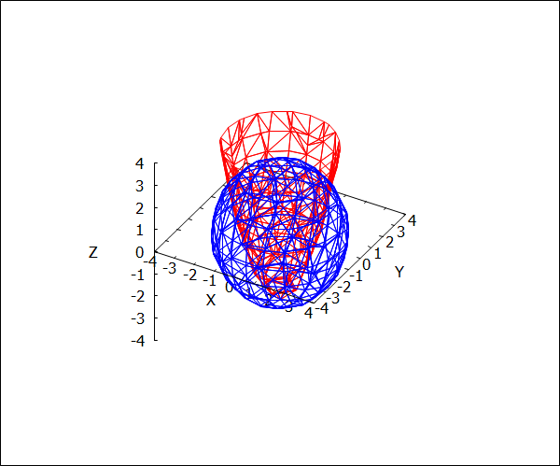
Solution

Slide 31
Divergence & Curl of a vector point function

Slide 32
Problem-6
Find the divergence of [x^2, y^2, z^2]?

Slide 33
Solution
load(vect);
f:([x^2, y^2, z^2]);
d:div(f);
f1:ev(express(d),diff);

Slide 34
Output
"C:\maxima-5.38.1\share\maxima\5.38.1_5_gdf93b7b_dirty\share\vector\vect.mac"
(f)[x^2,y^2,z^2]
(d)div([x^2,y^2,z^2])
(f1)2*z+2*y+2*x

Slide 35
Problem-7
Find the curl of the vector function [x*y, y*z, z*x]?

Slide 36
Solution
load(vect);
f:([x*y, y*z, z*x]);
c:curl(f);
f1:ev(express(c),diff);

Slide 37
Output
"C:\maxima-5.38.1\share\maxima\5.38.1_5_gdf93b7b_dirty\share\vector\vect.mac"
(f)[x*y,y*z,x*z]
(c)curl([x*y,y*z,x*z])
(f1)[-y,-z,-x]

Slide 38

Problem-8
Show that $\left\langle 3y^{4}z^{2},4x^{3}z^{2},3x^{2}y^{2}\right\rangle$ is solenoidal.

Slide 39
Soln :
load(vect);
f:([3*(y^4)*(z^2), 4*(x^3)*(z^2), 3*(x^2)*(y^2)]);
d:div(f);
f1:ev(express(d),diff);

Slide 40
Output
"C:\maxima-5.38.1\share\maxima\5.38.1_5_gdf93b7b_dirty\share\vector\vect.mac"
(f)[3*y^4*z^2,4*x^3*z^2,3*x^2*y^2]
(d)div([3*y^4*z^2,4*x^3*z^2,3*x^2*y^2])
(f1)0

Slide 41

Problem-9
Find the divergence and curl of $\left\langle grad\left(x^{3}y+y^{3}z+z^{3}x−x^{2}y^{2}z^{2}\right)\right\rangle$.

Slide 42
Solution
load(vect);
g:grad(x^3*y+y^3*z+z^3*x-x^2*y^2*z^2);
f:ev(express(g),diff);
c:curl(f);
f1:ev(express(c),diff);
d:div(f);
f2:ev(express(d),diff);

Slide 43
Output
"C:\maxima-5.38.1\share\maxima\5.38.1_5_gdf93b7b_dirty\share\vector\vect.mac"
(g)grad(x*z^3-x^2*y^2*z^2+y^3*z+x^3*y)
(f)[z^3-2*x*y^2*z^2+3*x^2*y,-2*x^2*y*z^2+3*y^2*z+x^3,3*x*z^2-2*x^2*y^2*z+y^3]
(c)curl([z^3-2*x*y^2*z^2+3*x^2*y,-2*x^2*y*z^2+3*y^2*z+x^3,3*x*z^2-2*x^2*y^2*z+y^3])
(f1)[0,0,0]
(d)div([z^3-2*x*y^2*z^2+3*x^2*y,-2*x^2*y*z^2+3*y^2*z+x^3,3*x*z^2-2*x^2*y^2*z+y^3])
(f2)-2*y^2*z^2-2*x^2*z^2+6*y*z+6*x*z-2*x^2*y^2+6*x*y

Slide 44
MAXIMA LAB-3

Slide 45
Problem-1
Verify Green's theorem for the 2xydx+x^2dy over the region y=x^2,y=1 and x=0.

Slide 46
Solution
M(x,y):=2*x*y;
N(x,y):=x^2;
wxdraw2d(xrange=[0,1],yrange=[0,1],
fill_color=green,
filled_func=true,
filled_func=1,
explicit(x^2,x,0,1),
filled_func=false,

Slide 47
color=yellow,explicit(1,x,-1,1),
color=red,explicit(x^2,x,-1,1));
integrate(integrate(diff(N(x,y),x)-
diff(M(x,y),y),y,x^2,1),x,0,1);
a:integrate((M(x,x^2)+N(x,x^2)*diff(x^2,x))
,x,0,1);
b:integrate((M(x,1)+N(x,1)*diff(1,x)),x,1,0);
c:integrate((M(0,y)*diff(0,x)+N(0,y)),y,1,0);
a+b+c;

Slide 48
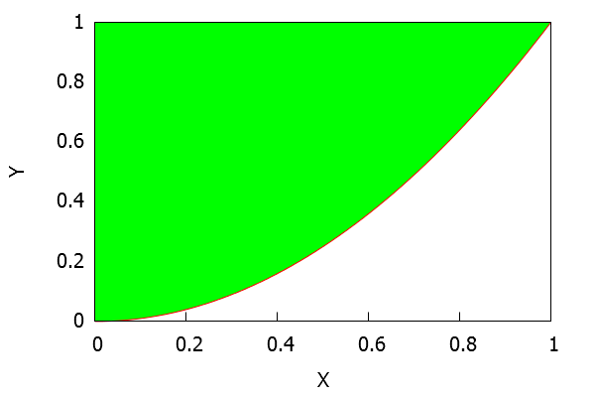
Output
(%o4) 0
(a)1
(b)-1
(c)0
(%o8) 0

Slide 49
Problem-2
Verify Green's theorem for the function y^2dx+3xydy, over the region bounded by the
upper half of the circle x^2+y^2=1,and the x-axis.

Slide 50
Solution
M(x,y):=y^2;
N(x,y):=3*x*y;
wxdraw2d(grid=true,xaxis=true,yaxis=true,
xrange=[-2,2],yrange=[-2,2],
fill_color=brown,filled_func=true,
filled_func=0,explicit(sqrt(1-x^2),x,-1,1),filled_func=false,

Slide 51
color=red,explicit(0,x,-1,1),
color=red,explicit(sqrt(1-x^2),x,-1,1));
integrate(integrate(diff(N(x,y),x)-diff(M(x,y)
,y),y,0,sqrt(1-x^2)),x,-1,1);
a:integrate(M(x,0),x,-1,1);
b:integrate(M(x,sqrt(1-x^2))+
(N(x,sqrt(1-x^2))*diff(sqrt(1-x^2),x)),
x,1,-1);
a+b;

Slide 52
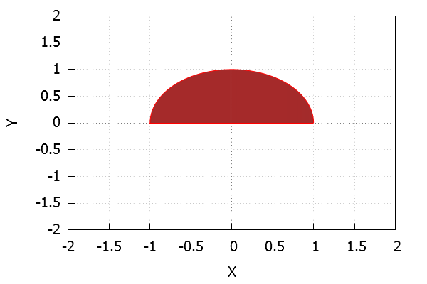
Output
2/3
(a)0
(b)2/3
(%o7) 2/3

Slide 53
Problem-3
Using stokes theorem evaluate integral(integral((curlF).n ds)) When F=[z^2,y^2,xy] and the curve C is the triangle defined by
(1,0,0),(0,1,0),(0,0,2).

Slide 54
draw3d(enhanced3d=true,triangle([1,0,0],[0,1,0],[0,0,2]));
load(vect);
F(x,y,z):=[z^2,y^2,x*y];
scalefactors([x,y,z]);
curl(F(x,y,z));
C:ev(express(%),diff);
gdf:grad(2*x+2*y+z);
ev(express(%),diff);
define(gdf(x,y,z),%);

Slide 55
N:gdf(x,y,z)/sqrt(gdf(x,y,z).gdf(x,y,z));
I:C.N;
K:[0,0,1];
J:N.K;
I/J;
ratsimp(%);
subst(2-2*x-2*y, z, %);
ratsimp(%);
integrate(integrate(%,y,0,1-x),x,0,1);

Slide 56
Output
[gr3d(triangle)]
(%o2) "C:\maxima-5.38.1\share\maxima\5.38.1_5_gdf93b7b_dirty\share\vector\vect.mac"
(%o3) F(x,y,z):=[z^2,y^2,x*y]
(%o4) done
(%o5) curl([z^2,y^2,x*y])
(C)[x,2*z-y,0]
(gdf)grad(z+2*y+2*x)
(%o8) [2,2,1]
(%o9) gdf(x,y,z):=[2,2,1]
(N)[2/3,2/3,1/3]
(I)(2*(2*z-y))/3+(2*x)/3
(K)[0,0,1]
(J)1/3
(%o14) 3*((2*(2*z-y))/3+(2*x)/3)
(%o15) 4*z-2*y+2*x
(%o16) -2*y+4*(-2*y-2*x+2)+2*x
(%o17) -10*y-6*x+8
(%o18) 4/3

